Slide 1

The AI Operations
Framework
Give your company somewhere to live — and an executive layer that can actually work in it.
A STEP-BY-STEP START
MeshPro × Expectus
Notes:
Twenty minutes from an empty folder to an organisation that writes itself down. Nothing to install, nothing to type but plain sentences. I will show you the whole thing and then you will do it yourselves.

Slide 2

THE PROBLEM
Where does your company actually live?
Ask two people in the same company the same question and you get two answers. Both of them are honest.
In people's heads
In a thread somewhere
In one spreadsheet
The person who knows how it works is on holiday, and the work stops until Tuesday.
It was decided. Nobody can find where, so it gets decided again, differently.
It is accurate. One person can open it, and they are the bottleneck for everything.
None of this is a discipline problem. There is simply nowhere for the answer to live, so it lives in whoever last dealt with it.
02
Notes:
Don't start with AI. Start with this. Everyone in the room recognises all three. The third one is the dangerous one, because it looks like it is working.

Slide 3

WHAT YOU GET
One page that cannot tell you
something untrue
Not a dashboard somebody keeps up to date. A page rebuilt from your own notes every time, by a machine that fails rather than guesses.
1
2
3
It is generated
It is checked
It says what is waiting
Nobody maintains it. It is rebuilt from the notes, so it cannot quietly go stale while everyone still trusts it.
Thirteen checks run over it. If the page would say nine and there are seven, the build fails.
Named, not counted — and what happens if nothing is done about each one.
03
Notes:
The failure mode of every internal dashboard is that it drifts and people keep believing it. The check is the difference: it is a failure, not a warning.

Slide 4
THE IDEA UNDERNEATH
Four rules. Everything else follows.
1
2
A fact has one home
Every surface is generated
If the same fact is true in two places, one of them is lying and you cannot tell which.
The page, the register, the agents. You never edit those — you edit the note that owns the fact.
3
4
A check fails on a false claim
Only a person decides
Not a warning nobody reads. The build stops.
Publishing, sending, spending, deleting. The machine prepares it all and stops.
04
Notes:
These four are the whole product. Everything in the package is one of these four made mechanical. If someone only remembers one, make it the first.

Slide 5
WHAT IT ACTUALLY IS
A folder of text files. That is the whole trick.
No database, no platform, no account to create. It sits on your own computer and you can read every file of it in Notepad.
THE VAULT
TO READ AND WRITE IT
TO DO THE WORK
A folder
Obsidian
Claude
Plain text notes, one fact each. Yours, on your machine. It still works if we never speak again.
Free, optional, and much nicer than Notepad. It is a reader for the folder — nothing lives inside it.
Connect the folder to a project. It reads the notes, writes the notes, and runs the checks.
You do not install Python, git, or anything else. You make a folder and you write sentences.
05
Notes:
This is the slide that lowers the shoulders in the room. Say the Python line out loud. Everything technical happens inside Claude, on their behalf, and the artefact left behind is text they own.

Slide 6
THE SETUP
Twenty minutes, four steps
None of these is a command. All four are things you say or click.
1
Make a folder
Anywhere. Name it after your company. Empty is correct.
2
Make a project in Claude, and connect the folder
A project remembers. Next week starts where today ended instead of starting from nothing.
3
Ask for the setup, in one sentence
It pulls the framework, installs it and runs the check. About a minute.
4
Open the page it made
Thirteen folders, three working agents, eight workflows, one page — and an honest report of what is missing.
06
Notes:
Walk them through it on screen while this slide is up. The honest report at step four matters — it will tell them they have almost nothing yet, and that is the product working.

Slide 7
STEP THREE, IN FULL
This is the whole of the technical part:
Set up the AI Operations Framework in my connected folder.
Pull it from the repository and run the install, then tell me
what it made.
Or your own words. It is read for intent, not matched against a format — if a session ever answers you with syntax to type, that session is wrong.
07
Notes:
Read it out. Then say: or anything that means the same. The point is that there is no syntax to get wrong — and if they are ever given some, that is a bug in how it was set up.

Slide 8
THE FIRST REAL STEP
Name your departments before anything else
Not because it is tidy. Because everything else needs an owner, and a department is where owners come from.
Three to six. Not twelve.
Write down what each one does not own
Say them out loud, in your own words — sales, delivery, the money stuff, the client stuff. If two of them would never disagree about anything, they are one department.
The same person can be behind several. The department is the unit of accountability, not of headcount.
The argument about where something belongs is cheaper now than in six months. Each department names the work people will assume is its and is not.
One department, one executive. With two, each assumes the other answered.
08
Notes:
The twelve-department instinct is universal — push back in the room. The not-owned list is the part everyone skips and the part that pays for itself.

Slide 9
WHAT THAT GIVES YOU
An executive layer that can do work
Each department note compiles into an agent that answers for that department and nothing else. Adding one later is the same sentence again.
You
Chief of Staff
Sales
Delivery
Finance
Operations
Workflow
Architect
One executive per department · one architect across all of them
09
Notes:
Four departments here is an example, not a prescription. Point at the Workflow Architect and explain that it owns how a workflow is written down, not what any department does.

Slide 10
THEN, ONE AT A TIME
Write down the process that annoys you most
Not the most important one. The one that goes wrong most often — because that is the one people will check you on.
It asks you the awkward questions
Two marks, because they fail separately
What starts it, what "done" actually means, who owns it, and — the part nobody writes down — where it breaks and how often.
It records the mess honestly, because a workflow note that describes the tidy version is worse than none.
Is the note true? Only a person who has walked a real case through it may say yes.
Does the workflow run end to end? That is a different question, and a documented organisation is not a working one.
10
Notes:
The two marks are the most original idea in the package. Most process documentation collapses them and then flatters itself. Ask the room: how many of your written processes have actually been walked?

Slide 11
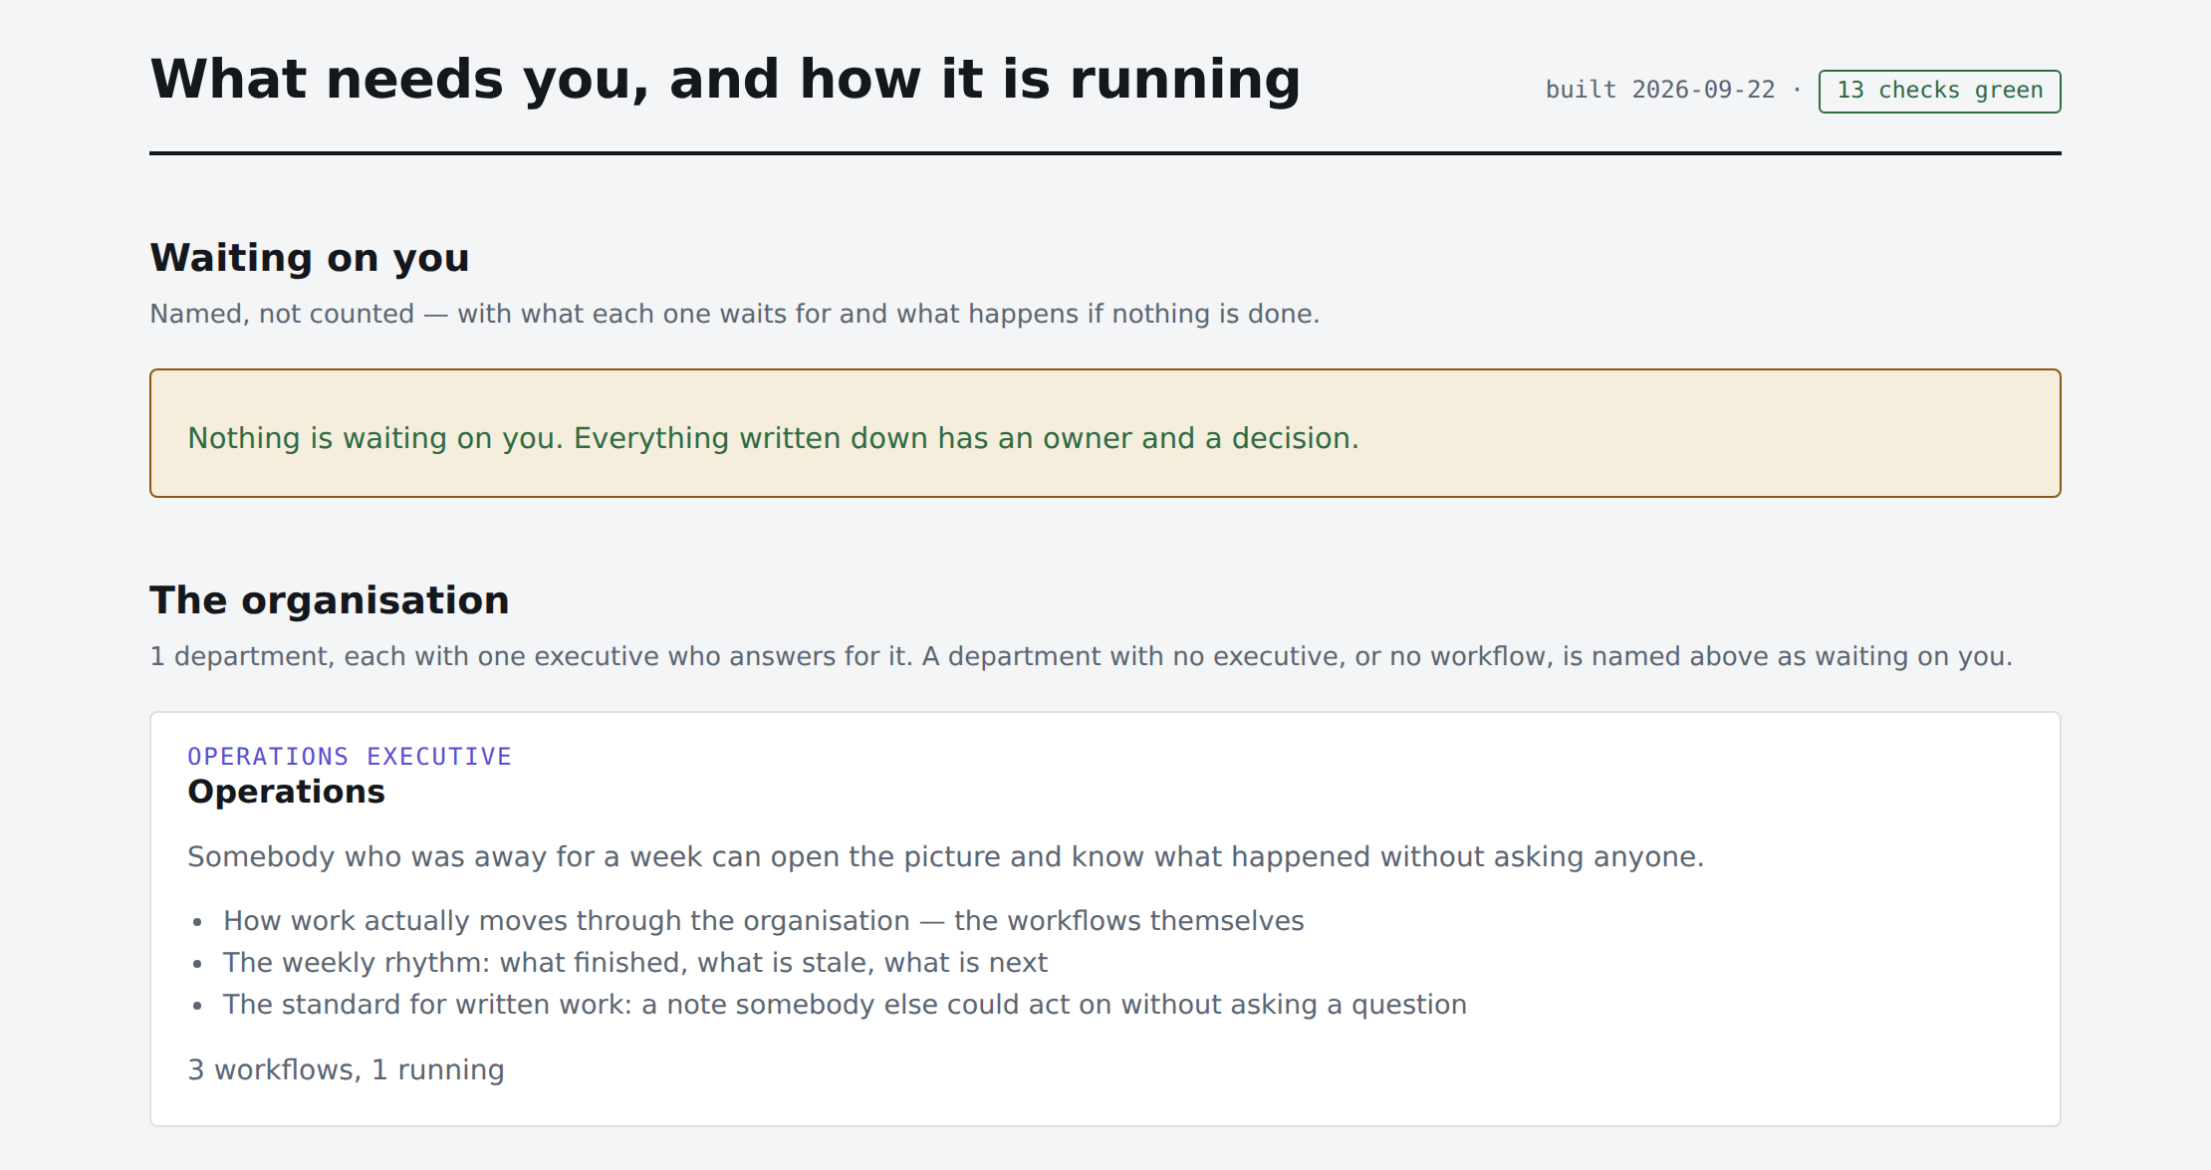
DAY ONE
What it looks like an hour in
Honest on day one
One department, three roles, and it says so. It does not pretend to be an organisation yet.
Green, and it means it
Thirteen checks ran against the notes. The number in the corner is measured, not typed.
11
Notes:
Show the real thing on screen if the room is small enough. The emptiness is the point — it is not a demo vault stuffed with fake content.

Slide 12
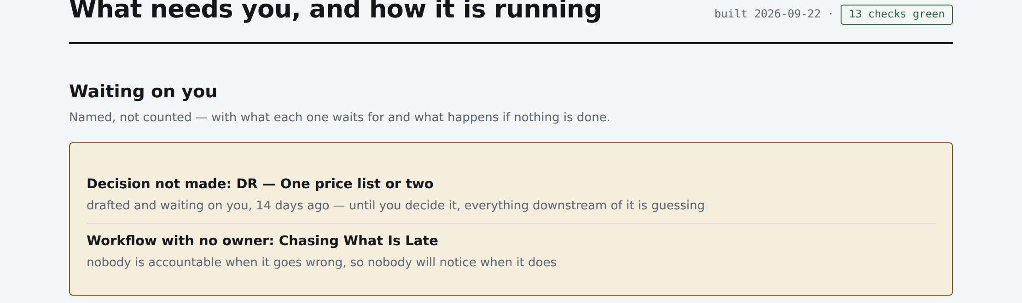
A FORTNIGHT IN
Two weeks later, it has found two things
Nobody reported either of them. The page counted them, off the notes, the way it does every time it is built.
Named, never counted. Not “two items need attention” — which decision, how long it has been sitting there, and what it is costing you to leave it.
12
Notes:
Fourteen days is the number to read out. Nobody chased that decision because nobody could see it. Also worth saying: the same page shows Finance with two workflows and none of them running — uncomfortable, true, and counted rather than admitted.

Slide 13
THE PART THAT MAKES IT TRUSTWORTHY
It tells you when you are wrong
A department invented, and a workflow pointing at one that does not exist — a typo. Three seconds later:
FAILED: every department has exactly one executive who answers for it —
'Sales' has no executive; every question about it lands back on you
FAILED: every workflow belongs somewhere — 'Running Your Week' belongs to
'Delivry', and there is no department note by that name
No jargon, no error code, no line number. It names the note and says what it costs you.
13
Notes:
This is the moment that sells it. Everyone has been burned by documentation that quietly went wrong. Point out that it caught a typo — Delivry — by name.

Slide 14
WHAT TO DO NEXT
Your first hour
—
Make the folder and connect it
Five minutes, and the only part that touches your computer.
—
Name your departments
Three to six, out loud, in your own words. Each gets an executive.
—
Write down the process that annoys you most
One. Including where it breaks.
—
Walk one real case through it
Only then is it validated — and only you can say so.
Installed in your vault, owned by you. Nothing here phones home.
Notes:
Send them away with one instruction, not four: name your departments. Everything else in the package hangs off that and they can do it in ten minutes.

